Slide 1
Collective Threat Intelligence Framework
PIP2001 Capstone Project
Review-0
Batch Number: CCS-G26
Roll Number | Student Name
20211CCS0169 | Ananya A B
20211CCS0106 | Aiswarya A S
20211CCS0109 | Jyotsna Banakar
20211CCS0052 | Vaibhav B Bharadwaj
Under the Supervision of,
Dr. Vennira Selvi
School of Computer Science and Engineering
Presidency University
Name of the Program: B-tech
Name of the HoD: Dr. Anandaraj S P
Name of the Program Project Coordinator: Dr. Sharmasth Vali Y
Name of the School Project Coordinators: Dr. Sampath A K / Dr. Abdul Khadar A / Mr. Md Ziaur Rahman

Slide 2
Content
Problem Statement
Analysis of Problem Statement
Timeline of the Project
References

Slide 3
Problem Statement Number: PSCS27
Organization: Quick Heal
Category: Software
Problem Description:
Adopting a collaborative approach to sharing the threat intelligence has its own benefits. The volume of threat incidences along with sophistication of techniques used demands implementation of effective protective system. You always see only view through one angle and no one has the full picture. Ability to find needle in a haystack gives the notion of today's threat landscape. The system should build capability of collective threat intelligence to prioritize, focus and detect threats.
Difficulty Level: Complicated

Slide 4
Analysis of Problem Statement
Technology Stack Components
Programming Languages: Python and Java
Databases: MySQL or MongoDB
Frameworks: Django (Python) or Spring Boot (Java)
Threat Intelligence Platforms (TIP):
MISP (Malware Information Sharing Platform): For collaborative threat data sharing.
OpenDXL (Open Data Exchange Layer): To integrate threat intelligence data from different sources.
Machine Learning Libraries: Scikit-Learn or TensorFlow
Data Visualization Tools: Grafana or Kibana
Security Tools:
Snort or Suricata: For intrusion detection system (IDS) integration.
Wireshark: For packet capture and analysis.

Slide 5
Analysis of Problem Statement (contd...)
Software Requirements
Operating Systems:
Linux (Ubuntu or CentOS) for server-side application deployment.
Windows/Mac/Linux for development workstations.
Development Tools:
Visual Studio Code or PyCharm for development.
Git: For version control and code collaboration.
Docker: For containerizing applications and managing environments.
Jira/Trello: For project management and tracking development progress
Database Software: MySQL or MongoDB
Cloud Integration (Optional): AWS or Google Cloud

Slide 6
Analysis of Problem Statement (contd...)
Hardware Requirements
Servers:
2 servers(min), each with 8-core CPUs, 16GB RAM, and 512GB SSD storage for data processing and analysis.
Workstations:
Minimum 8GB RAM and multi-core processors for development tasks.
Network Devices:
High-performance routers and firewalls for secure communication.

Slide 7
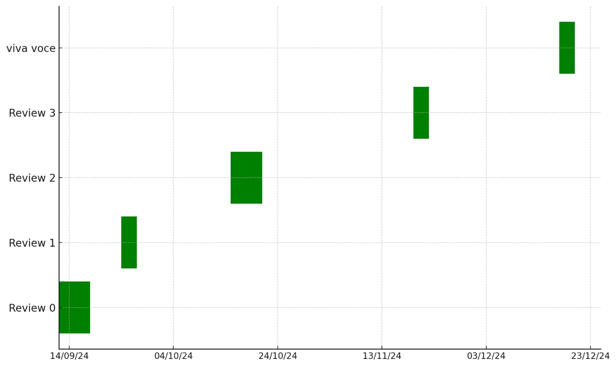
Timeline of the Project

Slide 8
References (IEEE Paper format)
Stewart, T., & Walker, P. (2020). Snort: Open-source intrusion detection and prevention system. Network Security Journal, 22(2), 120-129. https://doi.org/10.1016/j.nsj.2020.02.015
Brown, A., & White, M. (2022). Machine learning algorithms for cyber threat detection: A review. IEEE Transactions on Cybersecurity, 14(1), 78-89. https://doi.org/10.1109/TCS.2022.3157123
Johnson, D., & Nguyen, L. (2023). Leveraging MISP for advanced threat intelligence sharing. Cybersecurity Analytics Review, 18(3), 102-115. https://doi.org/10.1109/CAR.2023.3198761
Koster, R., & McLeod, J. (2021). Collaborative threat intelligence: Techniques and challenges. Journal of Information Security, 12(4), 345-362. https://doi.org/10.1007/s10207-021-00567-8

Slide 9


